Slide 1

ITEC2706 B
Group 21
TOPIC: Smart Mobile Technologies in Intelligent Transportation System (Smart public transportation management systems).
GROUP MEMBERS:
Fatima Patel (229553610)
Harshvardhan Chauhan (239570380)
Kshirja Patel (229558450)
Payal Pandav (229523190)
Upal Patel (229698190)

Slide 2
INTRODUCTION
The integration of sophisticated technology and data-driven solutions to improve the efficiency, safety, and overall effectiveness of public transportation networks is referred to as a Smart Public Transportation System.
The objective is to give both passengers and operators with a smooth and intelligent transportation experience. Some key features and components typically associated with a Smart Public Transportation System:
Real-time Data and Monitoring
Mobile Applications and Ticketing
Connectivity and Communication
Predictive Analytics
Automated Fare Collection
Smart Infrastructure
Electric and Sustainable Transportation
Traffic Management and Control
Safety and Security Measures
Feedback and Customer Engagement

Slide 3
CONTENTS
What is it? (e.g., infrastructures, standards, proposal etc.)
What are the objectives? / What problems are solved?
What mobile technologies are employed in it?
What types of connectivity/communication technology does it use?
Drawing and a labeled diagram of the system from our design.
What are the special challenges in it?
Design of the digital prototype for the mobile application using the software FIGMA.

Slide 4
What is it ?
Integration of modern technology and data-driven solutions
Enhance efficiency, security, and overall performance
Intelligent Transportation Systems (ITS) for real-time monitoring
Communication networks facilitating data exchange
Data analytics for informed decision-making
Mobile applications providing real-time information and ticketing options
Includes adaptive traffic signals and digital displays at bus stops
Contributes to seamless operations
Address data security and overall system safety
Tools include surveys and social media
Ensure ongoing improvements based on user preferences

Slide 5
What are the objectives?
Address challenges and improve overall effectiveness, safety, and efficiency of public transportation.
Optimize system productivity (Minimize delays, Improve routes, Enhance commuters' preference for public transport).
Ensure credibility of timetables (Reduce delays and interruptions, Increase precision of arrival and departure times, Build passenger trust).
Enhance security (Utilize real-time monitoring, deploy surveillance cameras, Implement collision avoidance systems, Lower accident rates and improve overall safety for users and drivers).
Efficient utilization of resources(Dynamically adjust staffing levels, routes, and timetables based on actual demand, Reduce resource waste).
Goal to cut down on traffic congestion(Promote public transit as a practical alternative to private vehicles, Contribute to a reduction in traffic jams and environmental impact).

Slide 6
What problems are solved?
Delays and inefficiencies in the system.
Routes that may not meet commuter preferences.
Timetable credibility issues.
Delays and interruptions impacting passenger trust.
Security concerns, accidents, and safety issues.
Inefficient resource utilization leading to waste.
Traffic congestion and environmental impact.
Suboptimal traveler experience without real-time information.

Slide 7
What mobile technologies are employed in it?
IoT (Internet of Things)
Wireless Technology (Mobile Connectivity Standards)
MEMS-based Sensors and Actuators
Data Processing with Soft Computing and Artificial Intelligence
Utilization of IoT-enabled devices for real-time data in vehicles and infrastructure
Integration of MEMS-based sensors into mobile devices for traffic monitoring
Application of wireless technology for data communication in transportation systems
Inclusion of mobile applications for data processing, situation awareness, and decision-making

Slide 8
What mobile technologies are employed in it?
Passive Monitoring
-Video cameras
-Infrared cameras
-Signal transmitters
Active Monitoring
-Use of predefined inputs and trajectories
-Generation of test signals for vehicle systems and infrastructure
Enhancing efficiency through real-time monitoring
Improving safety with active control and detection systems
Supporting decision-making with data processing and AI
Integration of technologies into a comprehensive Smart Public Transportation Management System

Slide 9
What types of connectivity/communication technology does it use?
Wireless Communications:
-Wi-Fi for internet connectivity and data exchange
-Bluetooth for short-range communication tasks like ticketing
Cellular Networks:
-4G/5G for high-speed data transfer
-Facilitates real-time communication between vehicles, control centers, and passengers
GPS Tracking:
-Provides accurate real-time location information for vehicles
-Aids in route optimization and passenger information
RFID (Radio-Frequency Identification):
-Used for electronic ticketing, including contactless smart cards
-Allows passengers to access public transportation services without physical ticket

Slide 10
What types of connectivity/communication technology does it use?
Ethernet and Controller Area Network:
-Ethernet Connectivity for in-vehicle communication networks
-Connects various components and systems
Cloud Computing:
-Involves centralized platforms for data storage and processing
-Supports efficient management and analysis of transportation-related data
IoT (Internet of Things):
-IoT Devices embedded in vehicles and infrastructure
-Enable real-time data collection and monitoring
-Contribute to system efficiency and performance
Satellite Communication:
-Ensures continuous communication in areas with limited terrestrial network coverage
-Enhances the system's reach and reliability
Inter-Vehicle Communication:
- Includes Vehicle-to-Vehicle (V2V) communication
-Improves traffic flow and safety by enabling vehicles to share information and coordinate movements

Slide 11
Create Account
Home or Search and offer
Login Screen
Reservation and Trip Search
Emergency Service
User Profile
Payment Processing
Feedback

Slide 12
What are the special challenges in it?
Integration challenges: Blending technologies like IoT and AI requires careful planning, hindering development and deployment.
Data security and privacy: Managing and safeguarding large data volumes needs robust cybersecurity measures.
Financial constraints: Obtaining funds for initial expenses is difficult, especially for cities with limited budgets.
Infrastructure adaptation: Updating existing systems for smart tech is complex, demanding upgrades.
User adoption: Inclusive design and education are vital for varied user groups, including those with impairments.

Slide 13
What are the special challenges in it?
Regulatory complexity: Navigating rules and legal concerns adds difficulty to smart transportation deployment.
Cybersecurity resilience: Effectively countering cyber threats is crucial for service continuity.
Public perception: Concerns about job displacement, resistance to change, and impact on daily commutes affect adoption.
Balancing benefits with sustainability: Ensuring smart transport improves efficiency without undue environmental impact is a challenge.
Scalability and futureproofing: Planning for urban growth and technological advances is crucial for sustained smart transit viability.

Slide 14

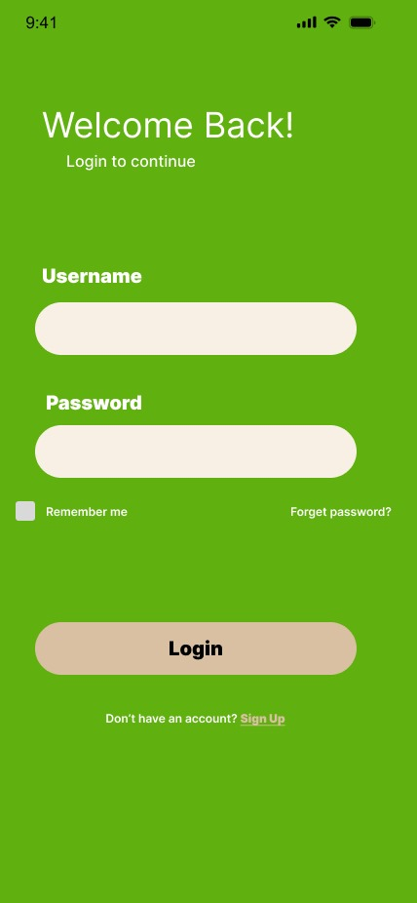


Design Prototype
Post Download Layout
New Account Layout

Slide 15
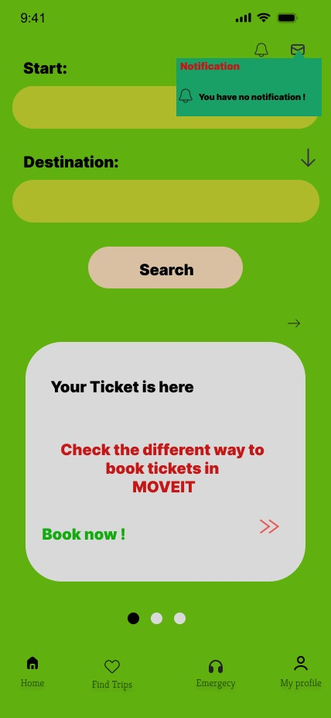
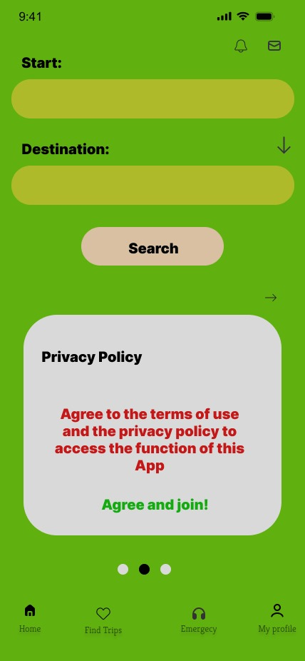
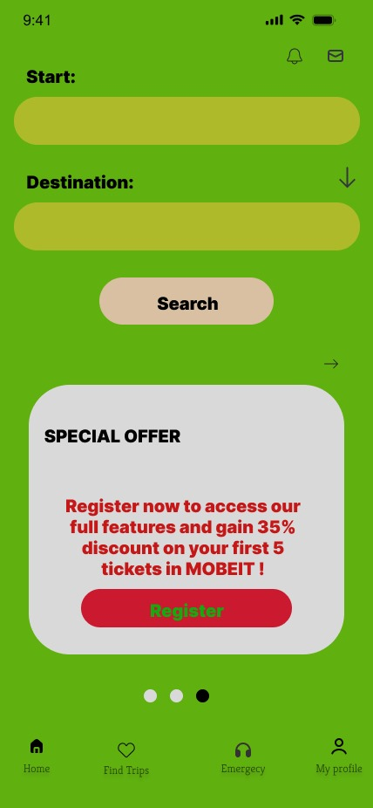
Design Prototype
Home Layout

Slide 16
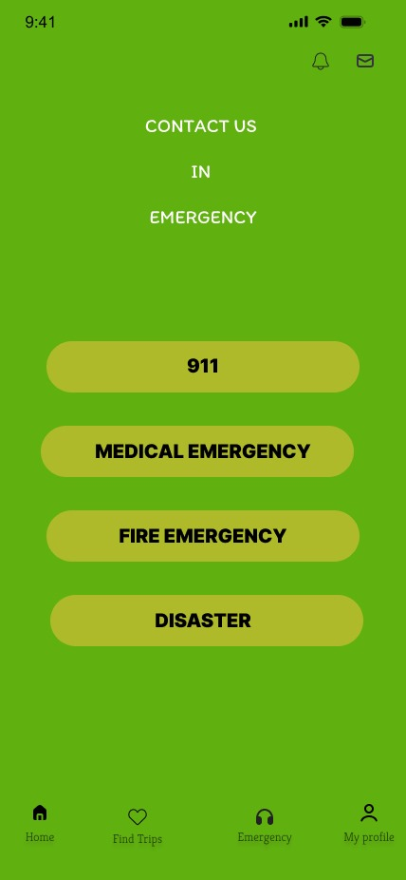
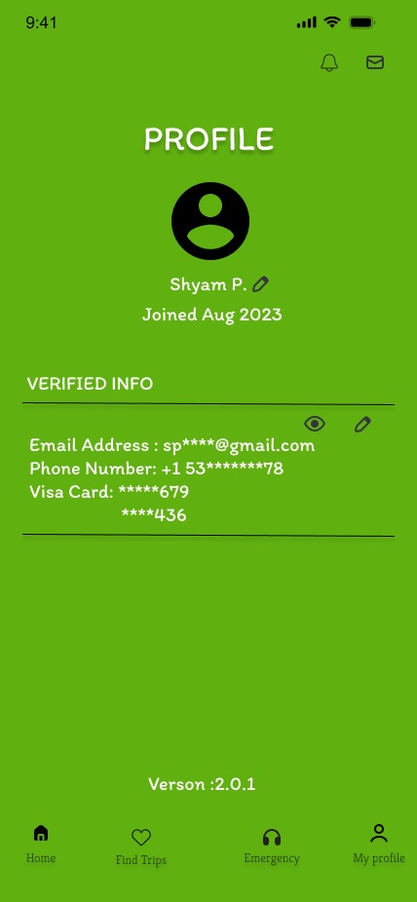
Design Prototype
Emergency Layout
Profile Layout

Slide 17
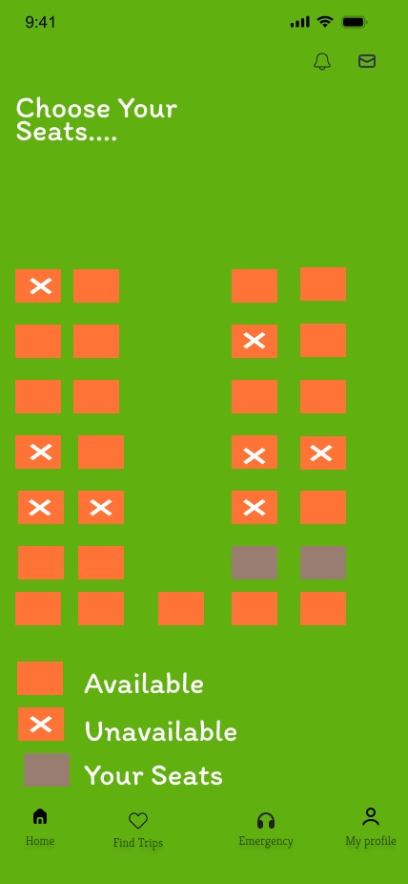
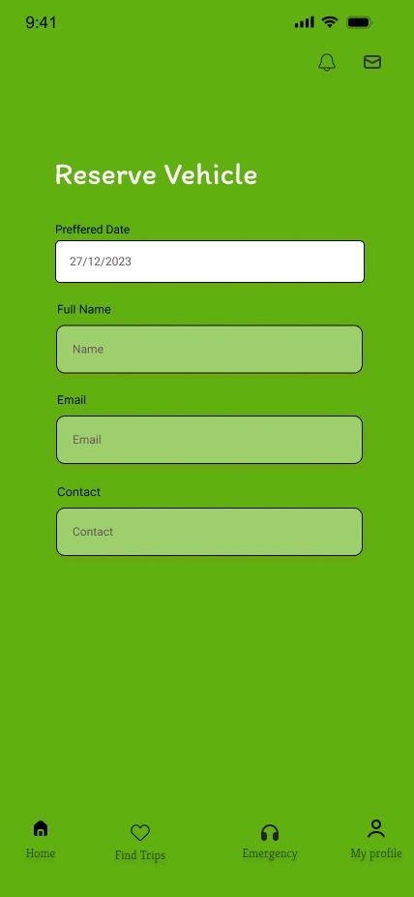

Design Prototype
Find Trip Layout

Slide 18
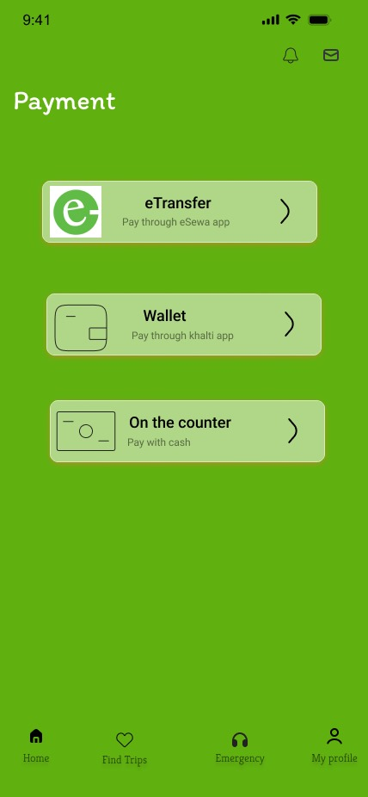
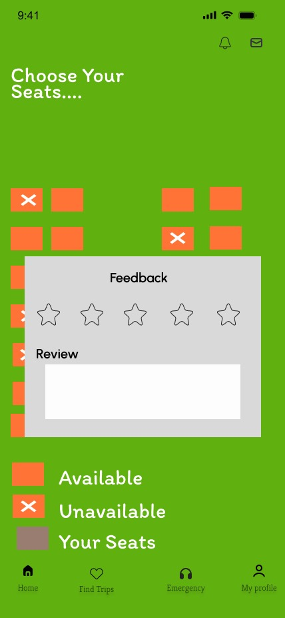
Design Prototype
Payment Layout
Feedback Layout

Slide 19
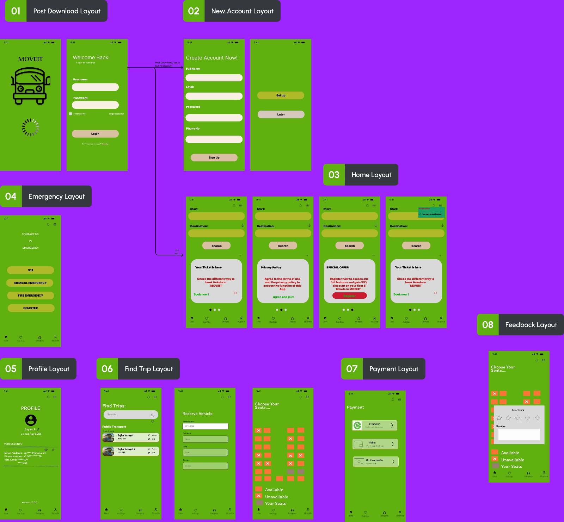
Whole Design Prototype

Slide 20
THANK YOU

